Slide 1
A distributed load balancer
Jinqing Yan

Slide 2
Agenda
Requirements
Current Architecture
Design Process Step

Slide 3
Requirements
Requirements Input
Functional Requirements
Use Cases
Quality Attributes
Constraints
Concerns

Slide 4
Requirements
Vodafone needs from Johan:
“The business driver is that Vodafone wants to be able to scale their vSBCs without touching the rest of the network. T-Mobile has the same requirement. They are also running out of connections on their PCRFs as every SBG blade needs an own Rx connection.
Vodafone wants to start with the Ic interface because they want to be able to scale their IBCFs without asking their interconnect partners to change their configuration (something which can take a long time to achieve)."

Slide 5
Requirements Input
vSBG shall implement a common framework for supporting load balancing on Layers 5-7 across multiple interfaces and protocols. Examples of interfaces that may be implemented using this engine: SIP, Diameter, H.248.
The framework shall be possible to install and run located on separate ADC VM according to the existing vSBG architecture.

Slide 6
Functional Requirements
This requirement describes the L5/L7 load balancing engine required to support a VIP on arbitrary interfaces which is required to support scaling and hide the internal architecture and topology to facilitate future architectural evolution.
The requirement wants to scale IBCFs. The lc interface should have the VIP support from the engine.

Slide 7
Functional Requirements
Application Aware Load Balancer
the application aware load balancer is L5/L7 layer. It supports to balance the service subscribers or links, based on specified protocol.
For lc interface, it means SIP application.
the balance should be strict.
L3/L4 load balancer
It offers VIP for access node and also function as load balancer for connections based on L3/L4, IP Port information. Since there has application load balancer, the connections doesn’t need evenly distributed.
Run Load Balancers inner separate ADC VMs.

Slide 8
Use Cases
Use case | Description
uc-1, Originated Foreign Call to Core network. | Hundred Originated TCP/UDP Call from foreign network, whose destination is VIP address, are handled evenly on Payload VMs and call must succeeds. For a TCP connection, it must be terminated on same ADC VM.
uc-2, Terminated Call from core work | ADC VM can send out TCP/UDP SIP request from PL VM and forward reply to correct PL VM. For a TCP connection, it must be terminated on same ADC VM.
uc-3, do configurations | Operator can do network configuration to Load Balancer and specify the number of Load Balancer.
uc-4, Scale in / Scale Out an ADC VM | Telcom operator can scale in or scale out its cluster nodes according to the capability of services.
uc-5, monitor the network link status | A network link sits between load balancer and external routers. when one link is down, it should show fault position and fire alarm; Clear alarm when link restores.
uc-6, security attack defense | The attacker can attack the system through different tools, DOS/DDOS. The system should can detect attacks and generate ALARM to operators. System also must survive.
uc-7, Multiple Network Calls simultaneous | The load balancer should can handle with multiple service networks

Slide 9
Quality Attributes
ID | Quality attribute | Scenarios | Use case
QA-1 | Performance | The system can handle with million Sip Calls at the same time. | uc-1; uc-2
QA-2 | Configurability | Operator can add, update or remove configurations at any time. | uc-3
QA-3 | Robustness | The system can run in months or years without a crash. | uc-1; uc-2; uc-6
QA-4 | Scalability | The system can be scaled in or out without traffics disturbance; New ADC VM can join to cluster and balance connections. | uc-4
QA-5 | Availability | The system can keep to supply service when one node gets down. | All use cases
QA-6 | Security | The system can detect attack and survive during attacked. | uc-6
QA-7 | Recoverability | The system can recover automatically from fault. | uc-1; uc-2
QA-8 | resiliency | The system can provide services during cluster glitch | uc-1; uc-2

Slide 10
Constraints
ID | contraints
cd-1 | There is no 3rd part component dependency
cd-2 | The system shouldn’t use any DB tool to store data.
cd-3 | A connection can be handled by any load balancer at different time point.
cd-4 | The system should locate in separate VMs.

Slide 11
Concerns
ID | Concerns
Concern-1 | Build up the first initial Arch Version
Concern-2 | External Router High Availability Solutions
Concern-3 | Current Scale In && Scale Out Steps
Concern-4 | Security over DPDK and iptables
Concern-5 | eVIP components

Slide 12
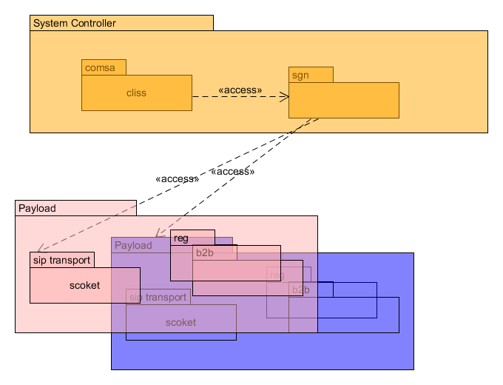
Current Architecture (module view)

Slide 13
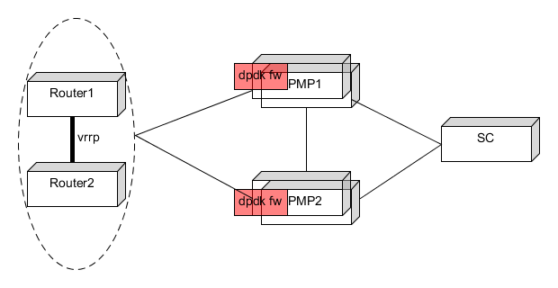
Current Architecture (deployment view)
All VM run in one ERLANG cluster;
Each PL VM can offer different service over different VLAN network at the same time;
Different Service uses different application protocol, like SIP, Diameter, H248….
Same service on different VM uses same VLAN and subnet.

Slide 14
Design Process Steps
Review Input
Establish iteration goal and select inputs to be considered in the iteration

Slide 15
Review Input
type | Description
objectives | Design a basic system to support L3/L4 Load Balancing
Main Functional requirements | UC-1; UC-2; UC-3;UC4;UC-6
Quality Attributes | QA | Priority to Customer | Risk to Arch.
 | QA-1 performance | high | high
 | QA-2 Configurability | high | low
 | QA-3 Robustness | middle | high
 | QA-4 Scalability | high | high
 | QA-5 Availability | high | high
 | QA-6 Security | Middle | low
 | QA-7 Recoverability | High | Middle
 | QA-8 Resiliency | Low | high
Constraints. | CD-1; CD-2; CD-3;
Concerns | All
Current Arch.

Slide 16
Iteration 1. System Architecture
Goals in this Iteration
Inputs in this Iteration
design concepts that satisfy the inputs considered in the iteration
Instantiating architectural elements, allocating responsibilities and defining interfaces
Sketch views and record design decisions
Perform analysis of current design and review iteration goal and design objectives

Slide 17
Sprint Goal
To complete the system architecture for L3/L4 Load Balancing.

Slide 18
Inputs in this sprint
This is the first design for L3/L4 load balancing system, limited to all constraints.
Concern-1 | Build up the first initial Arch Version
Concern-2 | External Router High Availability Solutions
Concern-5 | eVIP components
QA-1 | Performance | The system can handle with million Sip Calls at the same time. | uc-1; uc-2
QA-2 | Configurability | Operator can add, update or remove configurations at any time. | uc-3
QA-3 | Robustness | The system can run in months or years without a crash. | uc-1; uc-2; uc-6
QA-5 | Availability | The system can keep to supply service when one node gets down. | All use cases
QA-7 | Recoverability | The system can recover automatically from service fault. | uc-1; uc-2

Slide 19
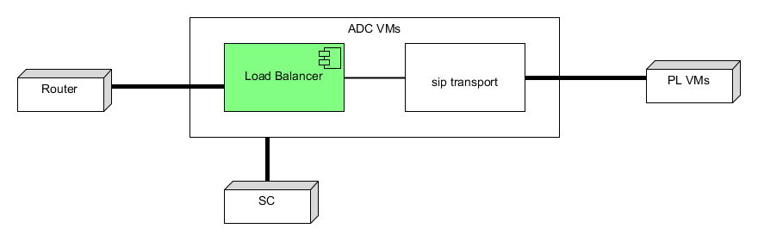
System Elements Decomposition
Load Balancer is the system we need to design as L3/L4 balancer; It has three interfaces: external router; Sip Transport and SC for OAM operation

Slide 20
Design Decision
Design Decision | Description
Add new load balancing system into current application archetype. | The new ADC VM should sit before PL VM. Erlang RPC can be used to do intercommunication among VMs. Inner ADC VM, it has L3/L4 load balancer and sip aware load balancer.

Slide 21
Choosing one or more design concepts that satisfy the inputs considered in the iteration Instantiating architectural elements, allocating responsibilities and defining interfaces Sketch views and record design decisions Perform analysis of current design and review iteration goal and design objectives

Slide 22
Technical Analysis (deployment view)
Shared external IP address in cluster
Legacy, For a specified network, different VM uses different IP address against the gateway, which means socket on different IP address on VMs.
Now, all VM has same IP address and open socket on same IP address.
ip1
ip2
ip3
ipx
vip
vip
vip
vip
PL VM1
PL VM2
PL VM3
PL VMn
PL VM1
PL VM2
PL VM3
PL VMn

